Slide 1

ANTOFAGASTA RACE PREVIEW
Elite Analysis · July 3 to 5, 2026
USA Triathlon High Performance

Slide 2
Race Week Schedule
Antofagasta
July 3 to 5, 2026 • Balneario Municipal, Av. República de Croacia, Antofagasta, Chile (CLT, UTC-4)
Fri • July 3
Sat • July 4
Sun • July 5
Familiarization & Briefing
CHAMPIONSHIP RACE DAY
Para / Youth / AG / Relay
Morning | Elite and Junior swim and bike familiarisation
Morning | Para triathlon swim and bike familiarisation
13:00 – 18:00 | Age-Group registration and kit collection
16:00 | ★ Elite and Junior pre-race briefing
16:45 – 18:15 | Elite and Junior registration and kit collection
TBD | Junior Women Championship, Sprint
TBD | Junior Men Championship, Sprint
TBD | ★ Elite / U23 Women Championship, Standard
TBD | ★ Elite / U23 Men Championship, Standard
16:00 | Para triathlon briefing
18:00 | Age-Group briefing
TBD | Para Triathlon Championship, Sprint
TBD | Youth Women Championship, Super Sprint
TBD | Youth Men Championship, Super Sprint
TBD | Age-Group Championship, Standard
TBD | 2x2 Mixed Relay, Elite and Juniors
Times Balneario Municipal, Av. República de Croacia, Antofagasta, Chile (CLT, UTC-4). Schedule confirmed from World Triathlon race-info page / athlete guide; subject to organiser updates.

Slide 3
Key Course Differentiators
Antofagasta
ANTOFAGASTA
COURSE AT A GLANCE
The 2026 Americas Triathlon Championships bring continental title racing to Antofagasta on Chile's northern desert coast. Racing is staged at the Balneario Municipal on Avenida República de Croacia, where the elite and U23 fields contest the standard distance on Saturday 4 July. Expect a cold Pacific swim cooled by the Humboldt Current, a flat, fast multi-lap bike on closed coastal avenues, and a flat seafront run. July is dry Atacama winter: mild highs near 18 C, cool mornings, and almost no rain.
Swim:
1.5 km, 2 laps × 750 m
Bike:
43.3 km, 8 laps × 5.41 km
Run:
10 km, 4 laps × 2.5 km
Format:
Standard-Distance Triathlon
COURSE FEATURES
Bike Laps:
8
Run Laps:
4
• Cold Pacific swim off the Balneario Municipal; the Humboldt Current holds water near 15 to 17 C, so plan for a wetsuit
QUICK LINKS
• Standard bike of 43.3 km over eight closed-road laps with a turnaround at each end; flat but technical on the U-turns
Current Race Info:
Race Info | 2026 Americas Triathlon Championships Antofagasta
• Flat 10 km seafront run, four laps on Avenida Grecia, with cool winter air keeping heat stress low
• Compact, spectator-friendly venue with transition, finish, and athlete services along the beachfront esplanade
• Continental title race; Elite and U23 contest the standard distance on Saturday 4 July

Slide 4
Course Profile & Map
Antofagasta
[PLACEHOLDER: Insert upcoming course map or race photo here] Right-click → Replace Image, or paste screenshot of the World Triathlon course map PDF.
[PLACEHOLDER: Insert previous year course map or race photo here] Right-click → Replace Image, or paste screenshot of the World Triathlon course map PDF.
2026 Course
2025 Course
Source: [PLACEHOLDER: World Triathlon event page URL]
Source: [PLACEHOLDER: World Triathlon event page URL]
Discipline | Distance | Laps | Terrain / Notes
Swim | — | — | [PLACEHOLDER: e.g. Open-water, Bay of Antofagasta]
Bike | — | — | [PLACEHOLDER: e.g. Flat coastal road circuit, closed course]
Run | — | — | [PLACEHOLDER: e.g. Flat multi-lap, cobblestone city-centre finish]

Slide 5
Swim Course Profile
Antofagasta
1.5 km • 2 × 750 m
Open ocean, Pacific coast cooled by the Humboldt Current
Distance
Layout
Start
1.5 km
Pacific Ocean off the Balneario Municipal, buoy-marked, counter-clockwise
Beach start on the Balneario Municipal esplanade
[Drop swim course map here] Save the organiser map as: ppt files/support/antofagasta_swim_course.png It will be embedded automatically on the next run.
Water Temp
Wetsuit
Lap Count
15.7 °C (7-yr avg)
Wetsuit mandatory (< 16 °C)
2
Tactical Notes
• Standard swim is two laps of 750 m with a beach exit and re-entry between laps
• Counter-clockwise, buoy-marked rectangle directly in front of the Balneario Municipal
• Cold Humboldt-cooled water near 15 to 17 C makes wetsuits and a strong first 100 m breath plan important
Source: 2026 Americas Triathlon Championships Antofagasta — NF Information Package
• Pacific swell and sea state can build off the open coast, so practice sighting on larger surface waves
• Short beach run from the water into a transition that lines the seafront esplanade
Not in race brief: Exact buoy count and turn layout (confirmed at familiarisation) • Day-of water temperature (filled from Open-Meteo Marine when available)

Slide 6
Bike Course Profile
Antofagasta
43.3 km • 8 × 5.41 km loops
Closed coastal avenues, Av. República de Croacia and Av. Ejército
[Drop course map here] Save the organiser course map as: ppt files/support/antofagasta_bike_course.png It will be embedded automatically on the next run.
Elevation / Lap
Total Climb
Avg Grade
Flat (no data)
—
—
Max Climb Grade
Wind
Loops
—
Pacific coast (sea breeze)
8 × 5.41 km
Tactical Implications
• Standard bike is 43.3 km, eight laps of 5.41 km on closed seafront avenues
Source: 2026 Americas Triathlon Championships Antofagasta — NF Information Package
• Southbound on Av. República de Croacia then Av. Ejército to the turnaround at the Military Facility access
• Northbound return on Av. Ejército then Av. República de Croacia to the turnaround at Plaza Rotonda Croacia Grecia
• Pancake-flat coastal road; the two turnarounds each lap reward bike handling and repeated re-accelerations
• Exposed oceanfront means a sea breeze can build through the morning and reshape the lead group

Slide 7
Run Course Profile
Antofagasta
10.0 km • 4 × 2.5 km
Paved seafront, Avenida Grecia along the Balneario
Distance
Lap Structure
Total Climb
10.0 km
4 × 2.5 km
Not published
[Drop run course map here] Save the organiser map as: ppt files/support/antofagasta_run_course.png It will be embedded automatically on the next run.
Avg Grade
Max ▲ / ▼
Heat Risk
—
Not published
LOW
Tactical Notes
• Standard run is 10 km, four laps of 2.5 km on a flat paved seafront
• Heads north on Avenida Grecia, west-side lane, to the turnaround at Antonio Toro Street
• Returns south on Avenida Grecia to the esplanade in front of the Balneario Municipal
Source: 2026 Americas Triathlon Championships Antofagasta — NF Information Package
• Flat and fast with eight passes through the turnaround zones over the four laps
• Cool Atacama winter air near 18 C keeps heat stress low even for the midday fields
Not in race brief: Aid-station spacing and penalty-box location (confirmed in the athlete guide)

Slide 8
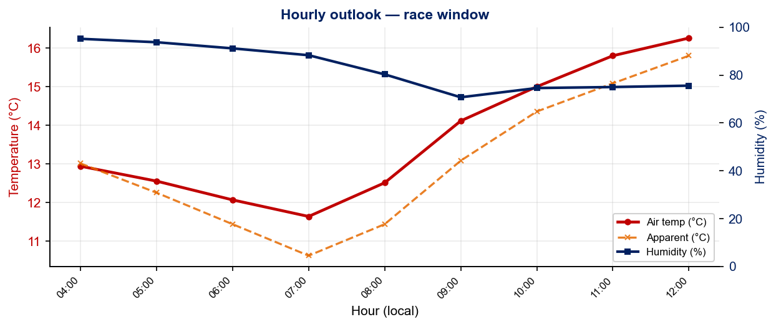
Race-Day Weather Outlook
Antofagasta
2026-07-04 • Historical climatology — same calendar day, 7-year mean
Hydration & Cooling Cues
• Cool to mild outlook — standard fluid plan (~500 ml/h), no special pre-cooling required
• Cold air pre-race — extended warm-up + warm clothing to lounge; wetsuit decision likely tilts mandatory if water tracks the same direction
Data source: Open-Meteo. Forecast will replace climatology once race day is within 16 days. Historical Race Conditions slide shows what actually happened in prior years.

Slide 9
Travel & Arrival Load
Denver, CO → Antofagasta race week
Core travel read
Denver to Antofagasta is a long-haul with no nonstop option. The cleanest athlete route runs through a US gateway to Santiago (SCL), then a domestic Chilean flight to Andrés Sabella Gálvez Airport (ANF), about 2 hours. Total door-to-door is typically a full day with an overnight long-haul leg. The time-zone shift is small (Antofagasta is 2 hours ahead of Denver), so jet lag is mild, but arrive several days early to absorb the travel and use the Friday familiarisation windows.
Primary route
Flight time
Time zones
Arrival airport
Transfer Distance
DEN → SCL → ANF
~16 to 20h
+2h
ANF (A. Sabella)
ANF → venue
2 stops likely
Plus layovers
Antofagasta ahead of Denver
~25 km north of city
~30 min by car
Host Hotel / Official Accommodation Read
Food / Grocery Options Near Hotel + Venue
• Official hotel: Enjoy Antofagasta, Av. Angamos 1455 (+56 55 265 3000), the venue for all briefings.
• Best stock-up: large supermarkets (Jumbo, Líder, Unimarc) and the Mall Plaza Antofagasta near the coast road.
• Recommended overflow: Holiday Inn Express Antofagasta (Av. Grecia esq. Antonio Poupin 1490).
• Quick basics: pharmacies (Cruz Verde, Salcobrand) for electrolytes and sports nutrition; convenience stores along Av. Grecia.
• Also recommended: Hotel Florencia Suites & Apartments, and NH Antofagasta.
• Restaurant read: seafront restaurants line the Balneario; plan simple athlete meals and be cautious with raw shellfish.
• All recommended hotels sit close to the Balneario Municipal race venue with easy access to the course.
• Venue note: the race precinct is compact and walkable from the beachfront hotels, so bring race-morning food from the hotel.
• Climate note: dry Atacama winter air is comfortable but dehydrating; keep fluids and lip/skin protection topped up.

Slide 10
Environmental Risk Profile
Antofagasta
RACE-DAY WEATHER (08:00 to 11:00 local)
AIR QUALITY (Open-Meteo archive)
Year | Date | Air Temp | Humidity | Wind km/h | Precip mm
Year | PM2.5 | EU AQI | UV Index | Risk
HEALTH & WATER QUALITY RISK FACTORS
• Water Quality: [PLACEHOLDER: Historical water quality data for Antofagasta, e.g. bacterial counts, EU Bathing Water Directive status, known algae / pollution events. Check local environmental agency reports for May race window.]
• Athlete Health Incidents: [PLACEHOLDER: Any known GI illness, respiratory, or heat-related incidents at this or comparable venues. E.g. Sunderland 2023, reported GI illness post-swim for multiple athletes.]
• Water Temperature: [PLACEHOLDER: Historical open-water temperature for Antofagasta in May (not available from Open-Meteo; check Copernicus Marine / NOAA or WT historical results).]
• Heat / Humidity Risk: Auto-derived from above table, flag if humidity >70% or air temp >25°C at race time.
Weather: Open-Meteo ERA5 archive (1940+). Air quality: Open-Meteo CAMS archive (coverage from ~Aug 2022; earlier years show blank). EU AQI: Good ≤20, Fair ≤40, Moderate ≤60, Poor ≤80, Very Poor >80.

